Slide 1
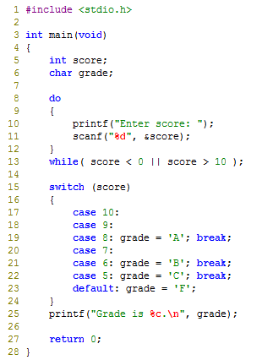
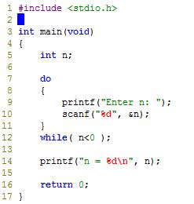
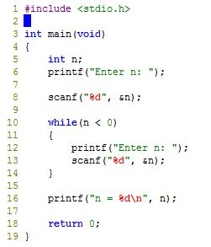
7b)
What the code does?
This program detects that if the user's input is more than 0, it would print out the input number.
Based on question 3. Check if user input is between 0 to 10. If it is, then run switch statements.
Rewrite in Do…While loop
Rewrite in While loop

